Slide 1
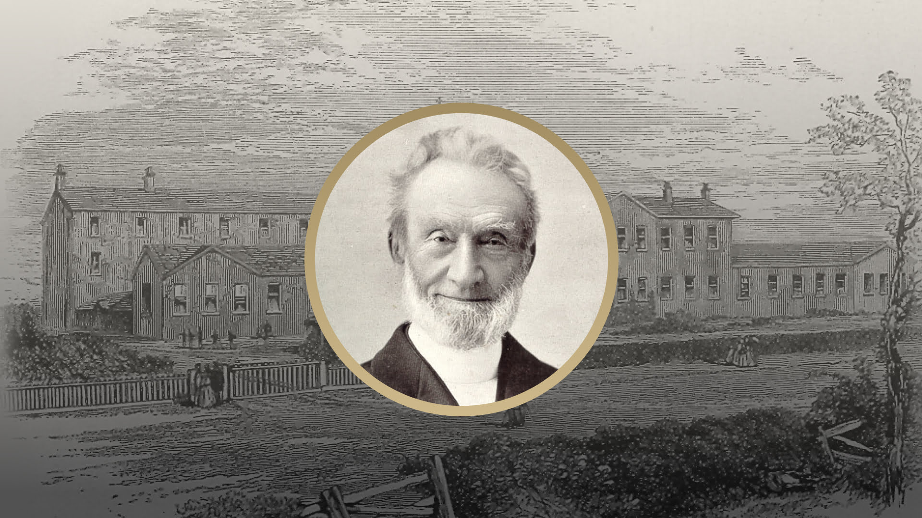

Slide 2
Leave a land to go to a land – Genesis 12
Don’t be snakey! – Genesis 12
United in Jesus and sharing the blessing – Genesis 13
Citizen of the city on the hill – Genesis 13
Walking with God – Genesis 13
In His name – Genesis 14

Slide 3
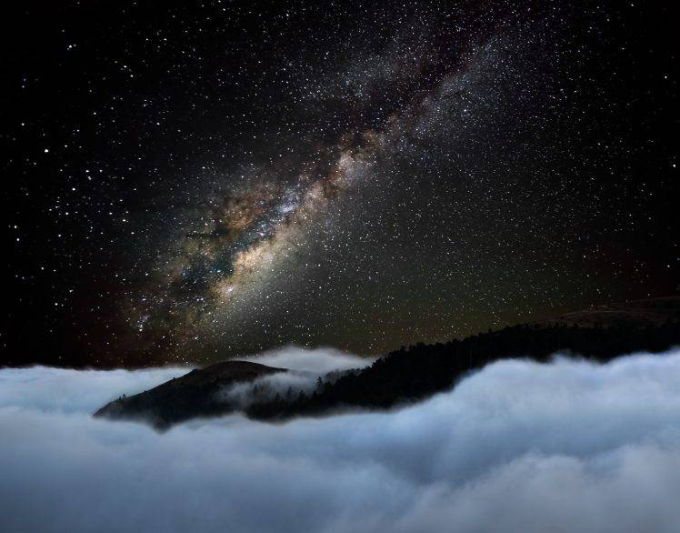
Leave a land to go to a land – Genesis 12
Don’t be snakey! – Genesis 12
United in Jesus and sharing the blessing – Genesis 13
Citizen of the city on the hill – Genesis 13
Walking with God – Genesis 13
In His name – Genesis 14

Slide 4
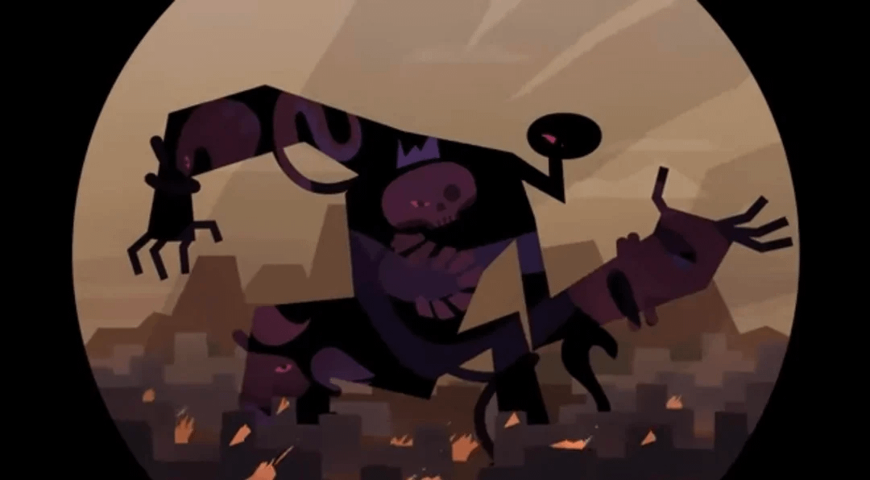
Leave a land to go to a land – Genesis 12
Don’t be snakey! – Genesis 12
United in Jesus and sharing the blessing – Genesis 13
Citizen of the city on the hill – Genesis 13
Walking with God – Genesis 13
In His name – Genesis 14

Slide 5
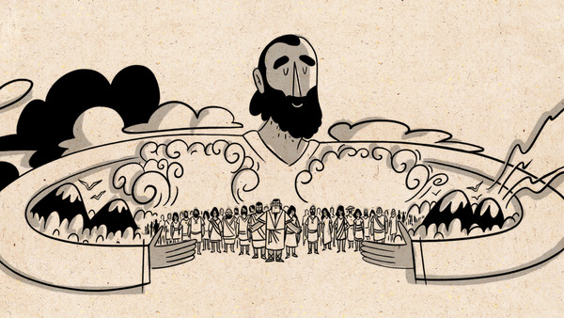
Leave a land to go to a land – Genesis 12
Don’t be snakey! – Genesis 12
United in Jesus and sharing the blessing – Genesis 13
Citizen of the city on the hill – Genesis 13
Walking with God – Genesis 13
In His name – Genesis 14

Slide 6
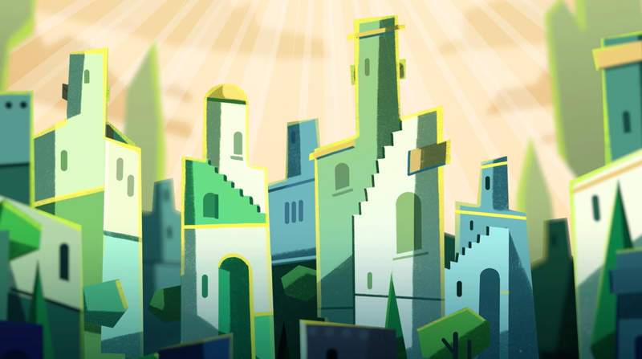
Leave a land to go to a land – Genesis 12
Don’t be snakey! – Genesis 12
United in Jesus and sharing the blessing – Genesis 13
Citizen of the city on the hill – Genesis 13
Walking with God – Genesis 13
In His name – Genesis 14

Slide 7
“For he was looking forward to the city with foundations whose architect and building is God”
“Instead, they were longing for a better country – a heavenly one”
Hebrews 11
“Two loves have made the two cities. Love of self, even to the point of contempt for God, made the earthly city; and love of God even to the point of contempt for self, made the heavenly city”
Augustine

Slide 8
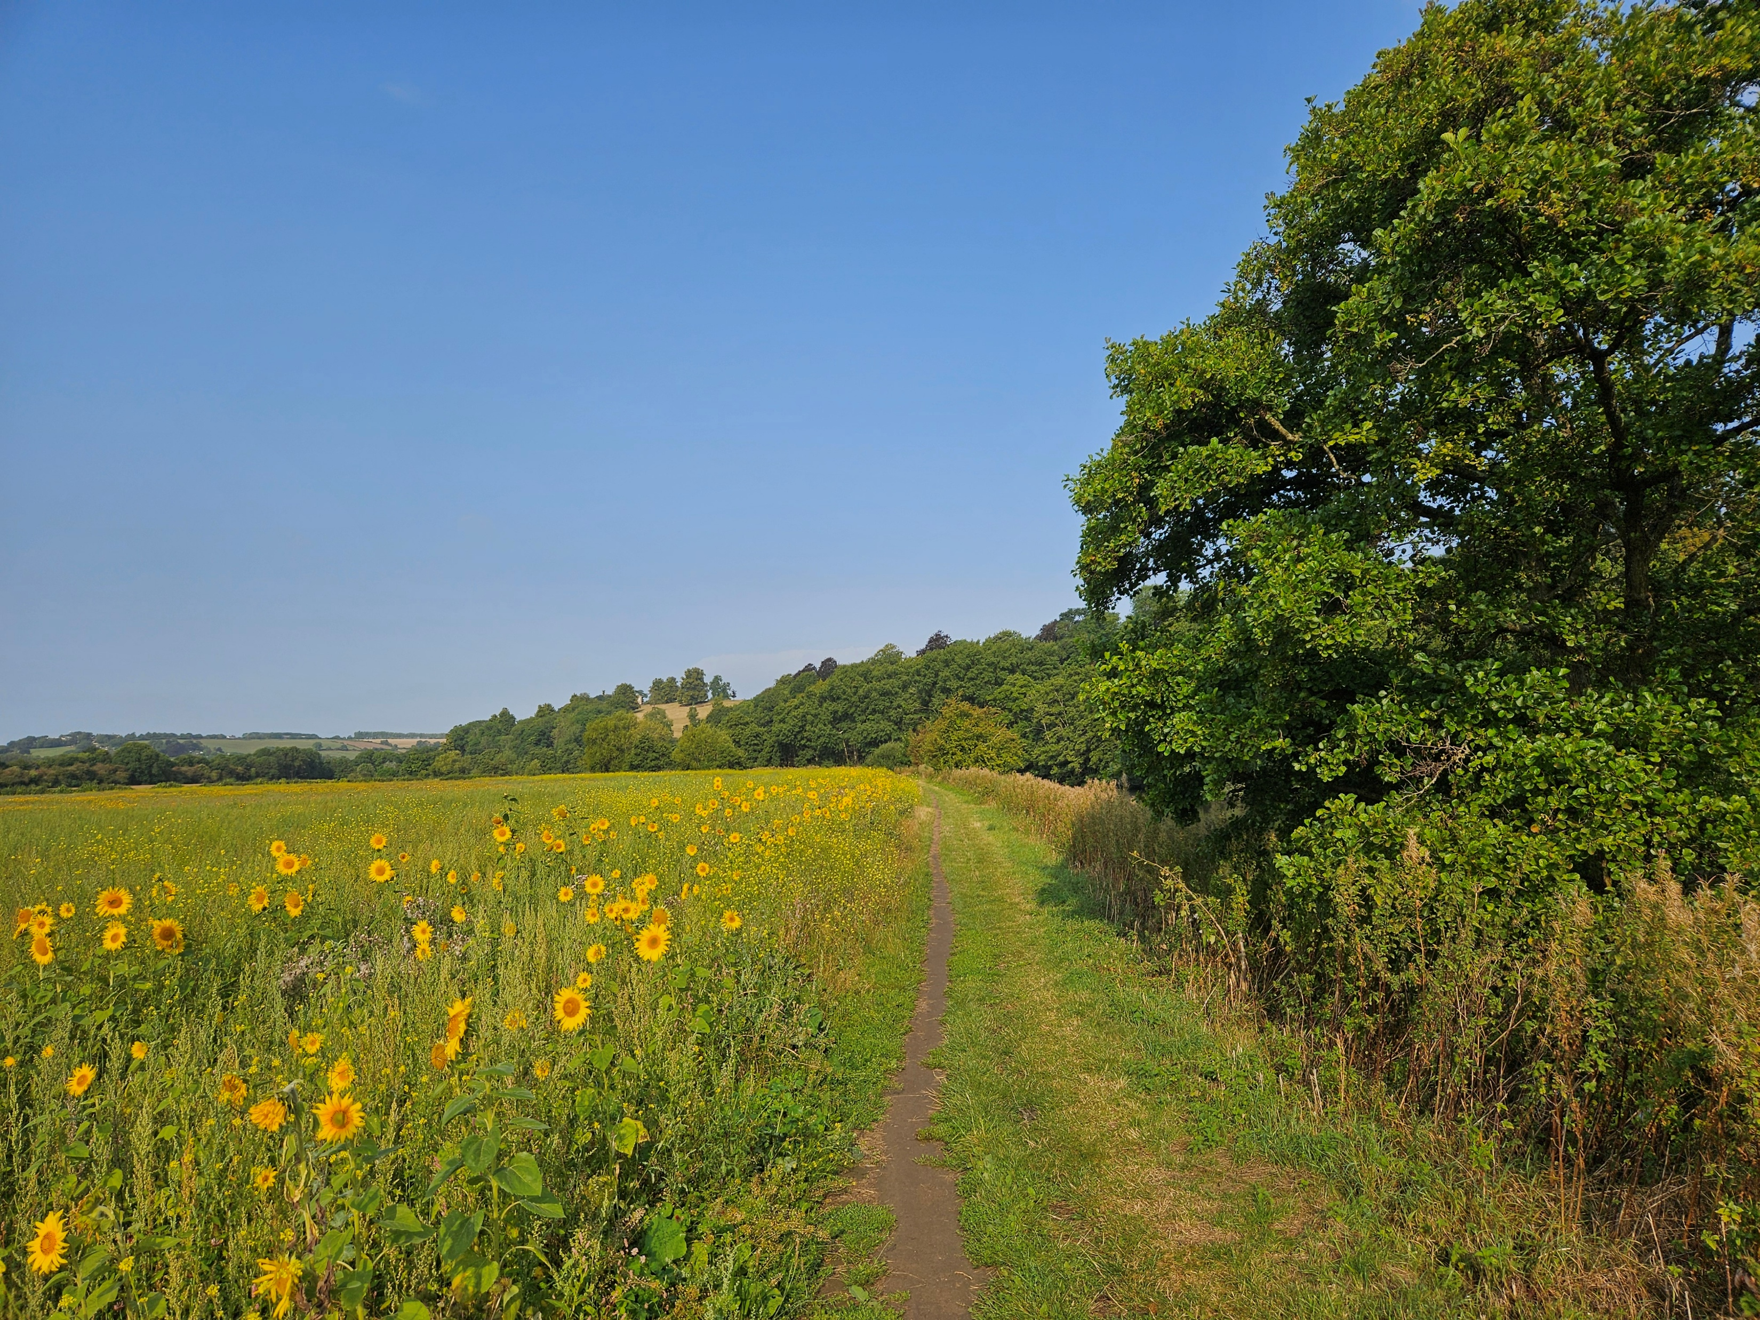
Leave a land to go to a land – Genesis 12
Don’t be snakey! – Genesis 12
United in Jesus and sharing the blessing – Genesis 13
Citizen of the city on the hill – Genesis 13
Walking with God – Genesis 13
In His name – Genesis 14

Slide 9
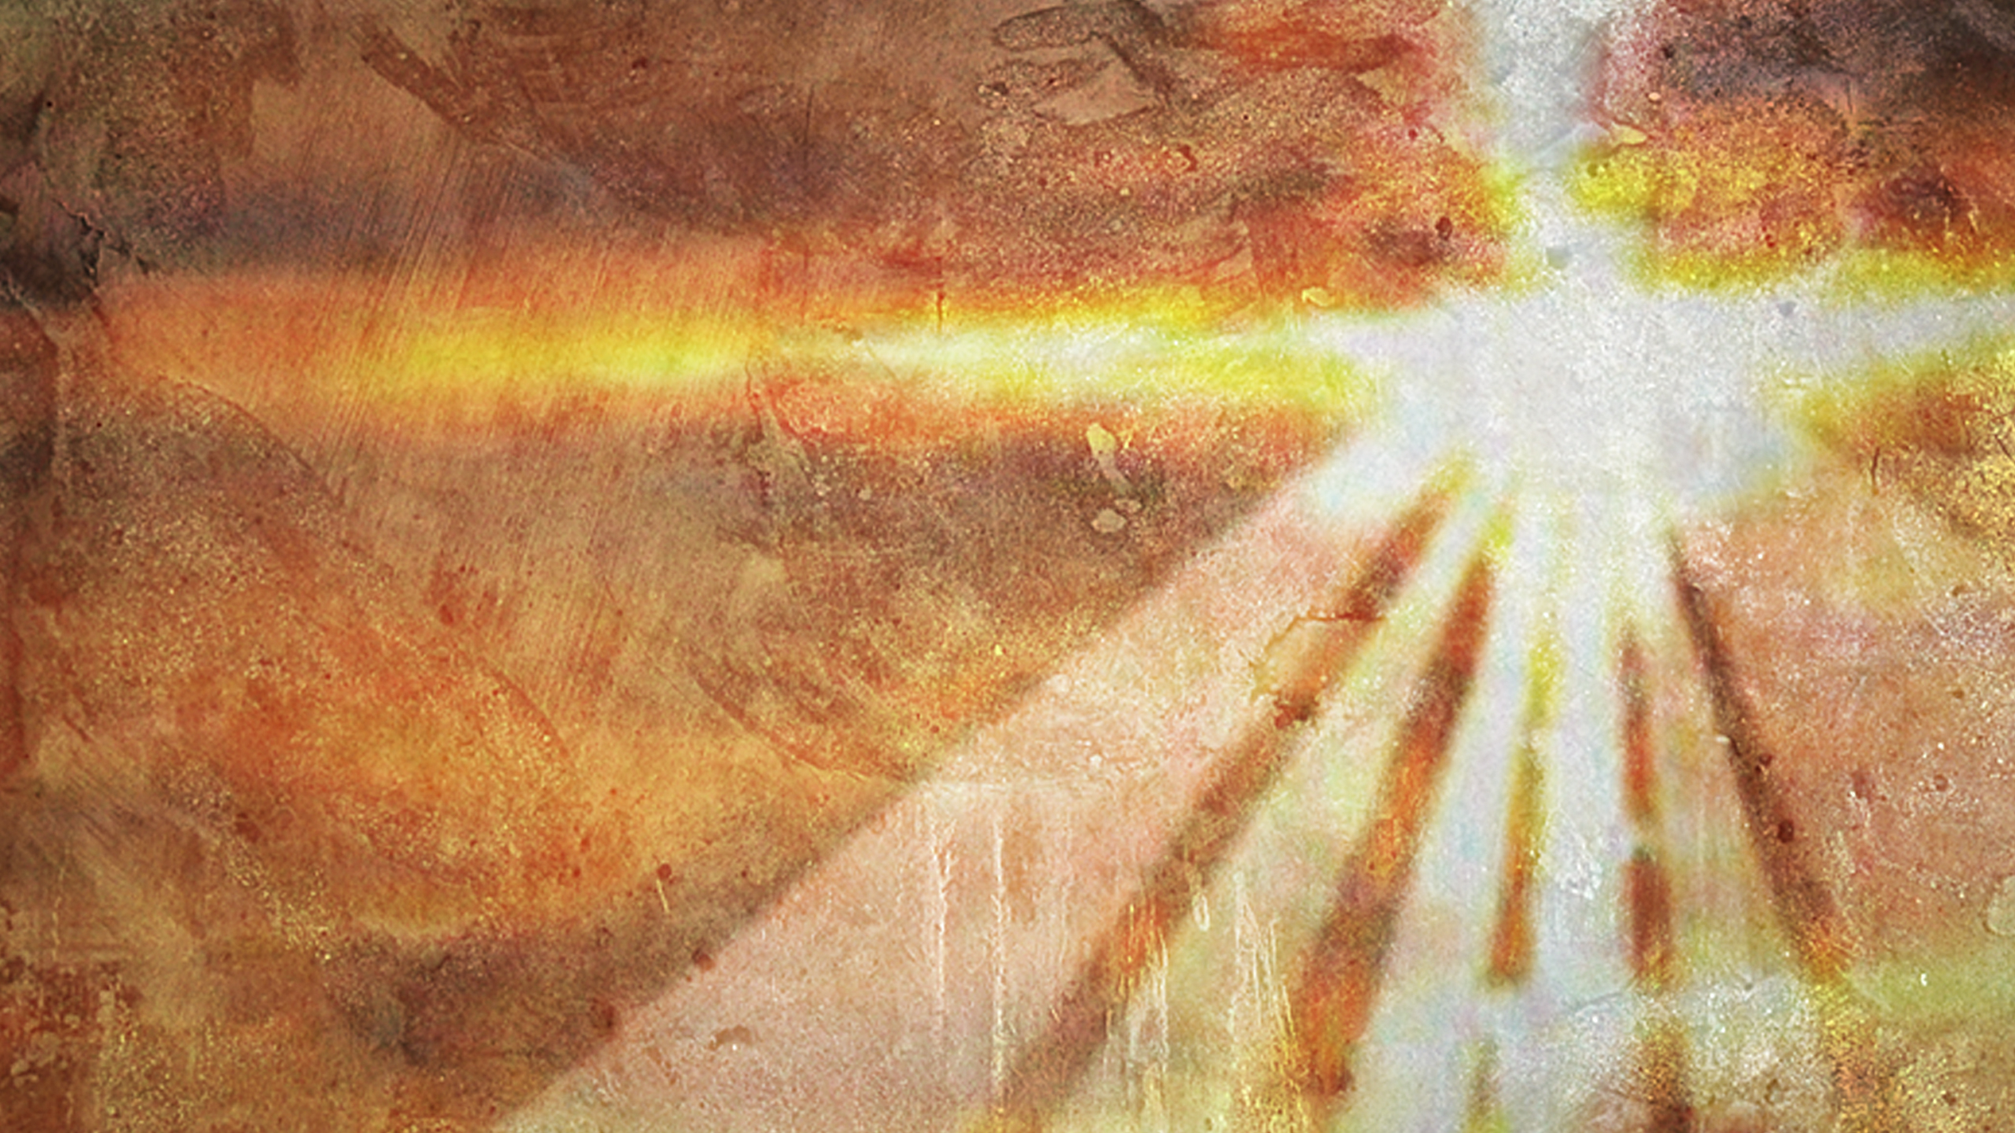
Leave a land to go to a land – Genesis 12
Don’t be snakey! – Genesis 12
United in Jesus and sharing the blessing – Genesis 13
Citizen of the city on the hill – Genesis 13
Walking with God – Genesis 13
In His name – Genesis 14

Slide 10
Leave a land to go to a land – Genesis 12
Don’t be snakey! – Genesis 12
United in Jesus and sharing the blessing – Genesis 13
Citizen of the city on the hill – Genesis 13
Walking with God – Genesis 13
In His name – Genesis 14

